Slide 1
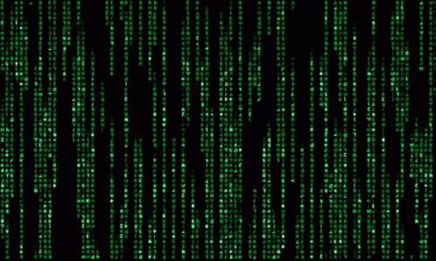
Unlocking the Power of the Command Line
Hyland Python Academy @ UCS
Notes:
Today we are going to show you how to unlock the power of the command line.

Slide 2

Notes:
Here’s a quick video showing how computers used to be for everyone back in the day.
Watch about a minute of this

Slide 3
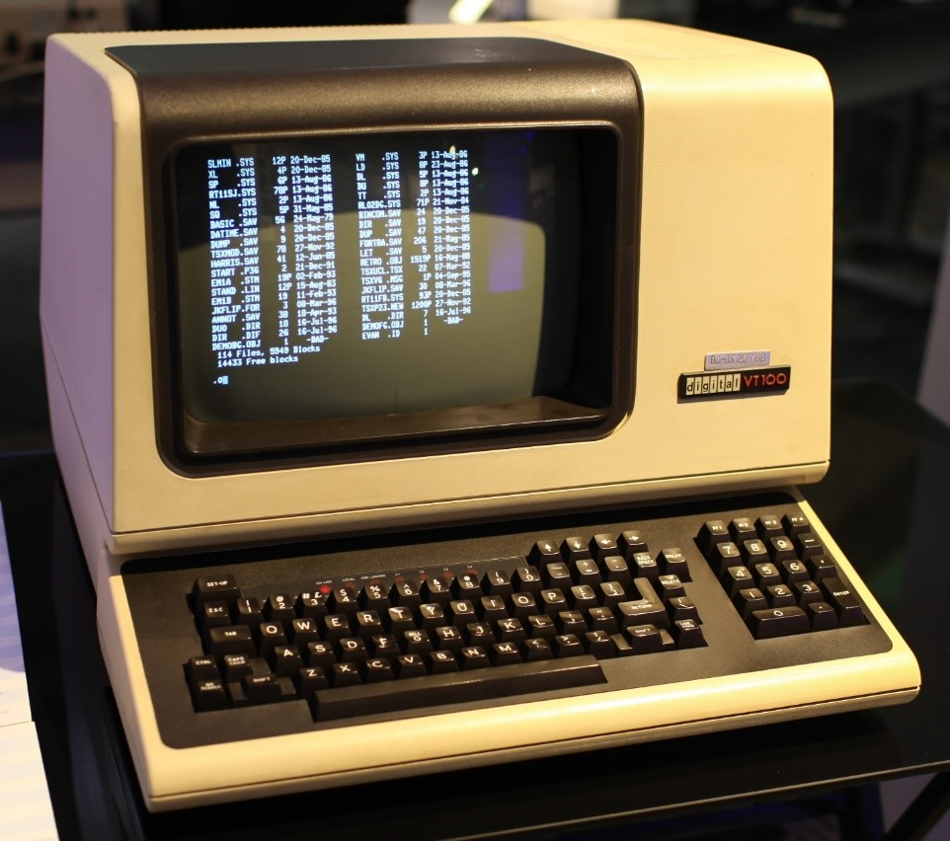

Before the GUI
Command-Line Interfaces (CLI) were once the primary means of computer interaction
Graphical User Interfaces (GUI): the modern-day visual programs we all know and love
Now, the command line provides the ability to perform complex tasks that cannot be achieved with the available features provided by the operating system’s GUIs
Notes:
How did people even survive back then? It was like pioneer times but for the world of computers.
Command-Line interfaces - programs based entirely on text – were all there really were! Anyone know what GUI stands for?
Graphical User Interfaces are used in almost every piece of software today. Things like websites, games, apps – all have GUIs (gooeys)
Today, while almost everything is GUI-based, there are still some use cases for the command line. Sometimes it’s just better, and sometimes it’s actually necessary!

Slide 4


Bash 💃🎉🎈🎊🥳
Shell programs allow you to run a variety of commands on your computer
Bash is a Unix shell and command language, and is the default shell on Linux and OS X
Notes:
Has anyone heard of a bash? Bash like a party? This is kind of like a party. But the SH stands for “shell” in this case.
A shell (not like in mario) allows you to run a variety of commands. It’s all text-based – it’s like a “shell” around the operating system.
Bash is a unix shell and command language – if you have a mac or a linux machine, it comes with bash.

Slide 5
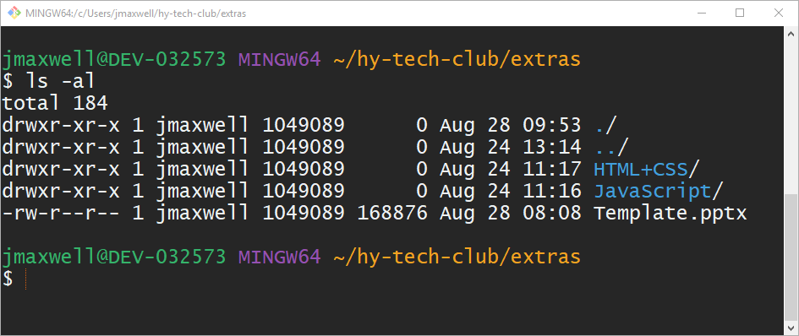
What does it look like?
System information
Command example
Command output
Command Prompt – where the user enters commands
Notes:
Let’s take a look at it!
The entry point to a shell is the command prompt. This is where you would type stuff in.
This is an example of a command you might type. When you type something, you press the enter key to enter it
Here’s an example of some output
And usually, you’ll see some sort of system information up here. It can be a lot to see, and hard to figure out, but becoming familiar and comfortable with this will go a long way if you want to be a real coder.

Slide 6
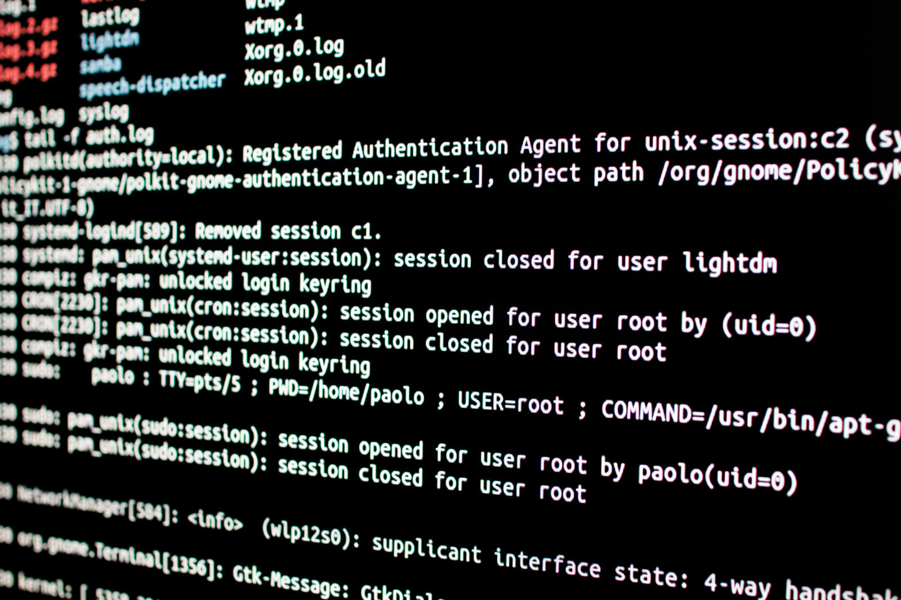
Bash Commands
Notes:
Now let’s get into some actual commands you can use.

Slide 7
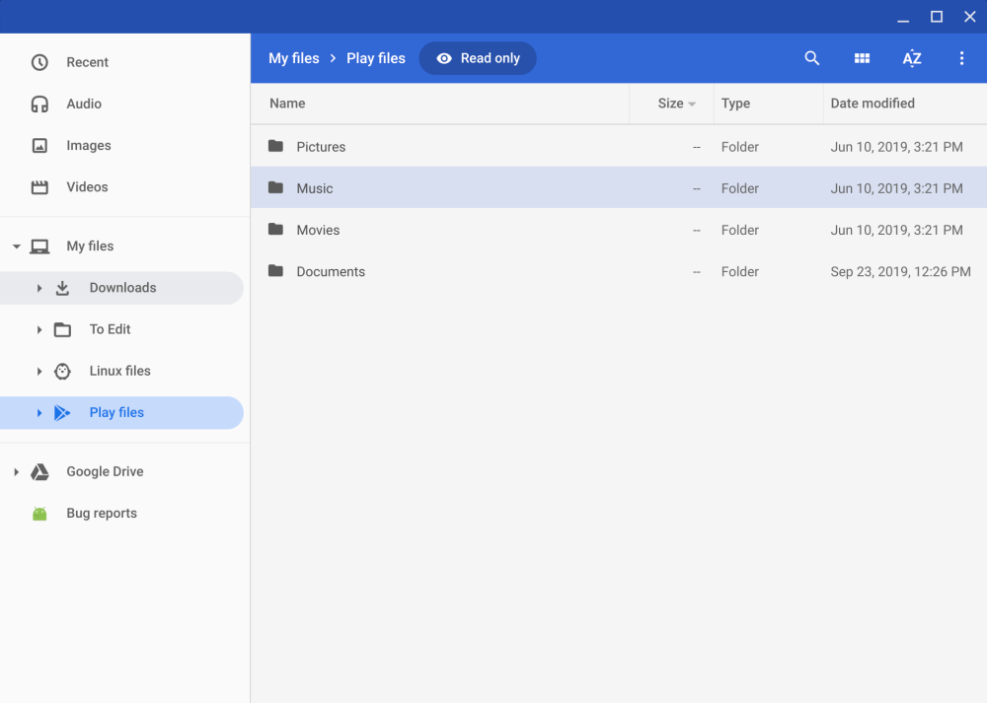
Basic Bash Commands
pwd – prints the working directory
A directory is a folder, just like in files
ls – lists the contents of the working directory
This will show both files and folders
cd – changes the working directory
This is the main way to move around in the file system
This command takes an argument to know where to go
Notes:
We’ll talk about some of the most basic commands.
PWD stands for present working directory. Anyone ever seen a folder before? That’s all a directory is – a folder on a computer. The shell has a memory of place, so it knows where you are in the folder tree.
LS stands for list – it lists the contents of the directory. Basically, just shows you what files are in the folder.
CD stands for change directory – it moves you to a different folder.

Slide 8



Helpful Tips
TAB – When typing out a command, pressing the TAB key will attempt to auto-complete it
UP – Pressing the UP key will cycle through your command history
Ctrl+C – Pressing the key combination of Ctrl and C will kill the current process
Notes:
A couple of helpful little tips to navigate the command line more efficiently
Anyone ever heard of this old soda? Tab cola. It basically does autocomplete for you, like when you’re searching on google
Up will just re-fill the last runned command
Control Sea will stop any process – not like copy! It’s different in the shell.

Slide 9
DEMO: Replit Shell
Notes:
Now let’s see the shell in action! Repl has a built in shell we can use.
Follow these steps (students do not need to follow along):
Click on the “Replit Shell” link: https://replit.com/@HylandOutreach/ShellCommands
Fork the project
Open the Shell (under Tools -> Shell button)
Try out some basic commands: pwd, ls, and cd
Show how to use TAB, UP, and Ctrl+C
An example for Ctrl+C could be running the “cmatrix” command and stopping it

Slide 10
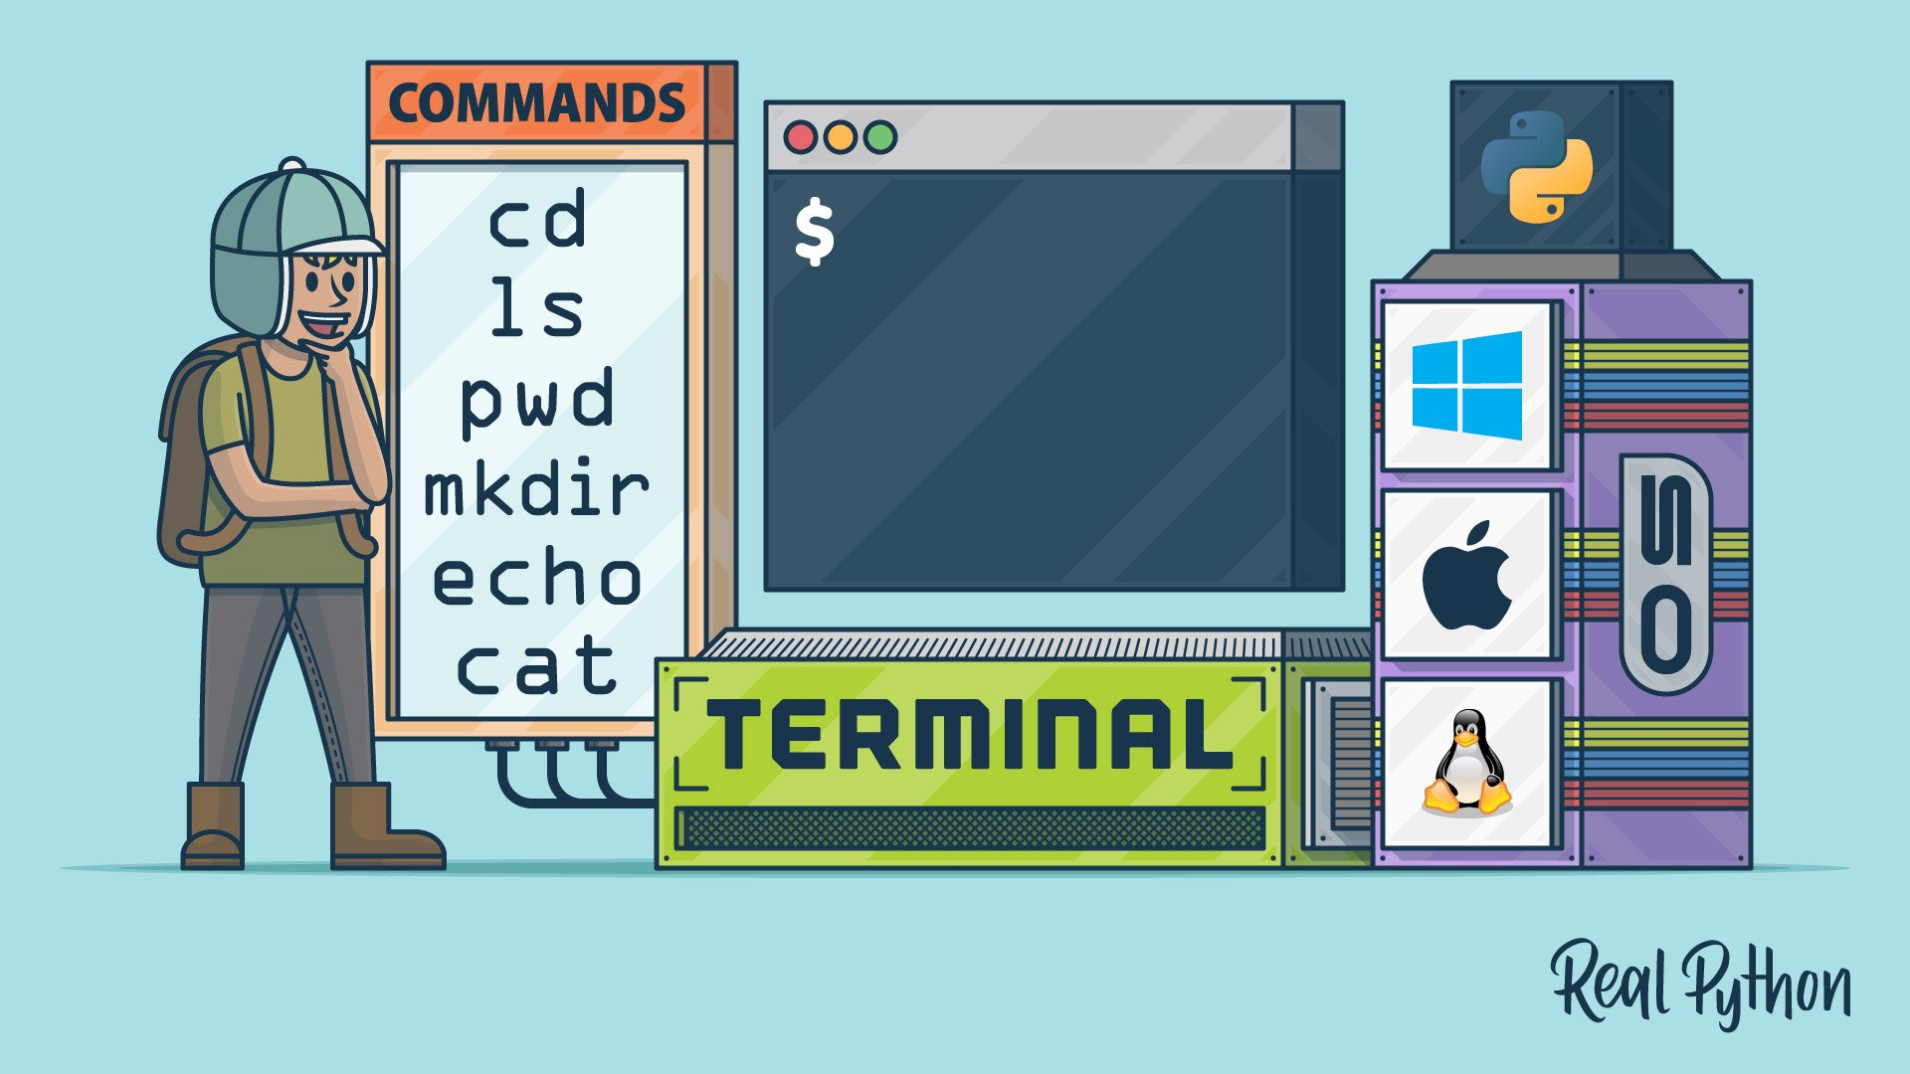
Python in the Terminal
The terminal is the simplest way to run Python scripts
Notes:
So, why are we learning about this? Well, Python is used extensively in the terminal (or console, or command line).
This is actually the simplest way to run Python scripts!

Slide 11
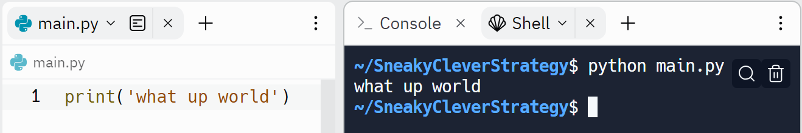
First Python Script
print("what up world")
"what up world"
Notes:
And now, for our first ever standalone script…
This print statement! That’s all we need for a command line application. Anyone know what this will do?
It prints what up world to the console. When Python reads, executes/runs this script (by running the `python main.py` command) – it shows up there in the command line.

Slide 12
Questions?
Hyland Python Academy @ UCS
Notes:
Anyone have any questions?

